Slide 1
Detrending, Deseasonalizing, & Smoothing

Slide 2
Purpose & Methods
 | Detrending | Deseasonalizing | Smoothing/Filtering
Purpose | To make the series stationary | To remove the obvious undulations from the series so that the finer details can be observed and modeled | To better see underlying trends, or use smoothed data to subtract from the raw data to expose seasonality
Techniques | Curve fitting and subtracting from raw data | Curve fitting and subtracting from raw data | Simple moving average
 | Differencing | Seasonal decomposition | Exponential moving average
 | Power transforms (Box-Cox) | Seasonal differencing | Hodrick-Prescott filtering
Primarily used to expose trends or perform decomposition
Essential for successful modeling

Slide 3
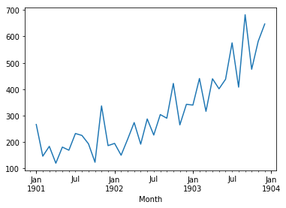
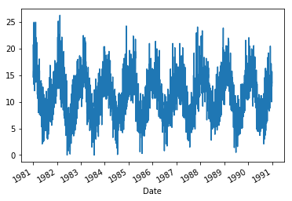
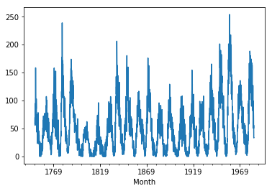
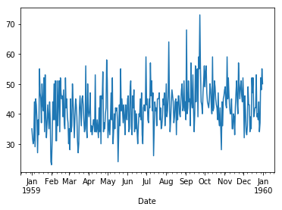
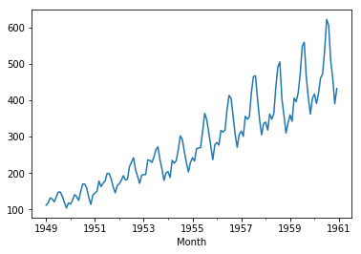
Data sets used in Brownlee’s book
Examples of time series exhibiting various amounts of trend, seasonality, and noise
 | Shampoo Sales | Minimum Daily Temperatures | Monthly Sunspots | Daily Female Births | Airline Passengers
Observations | 36 | 3650 | 2820 | 365 | 144
Trend | X |  |  |  | X
Seasonality |  | X | X |  | X

Slide 4
Detrending

Slide 5
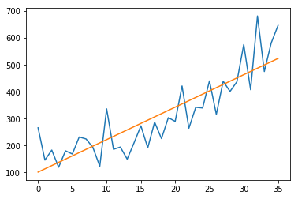
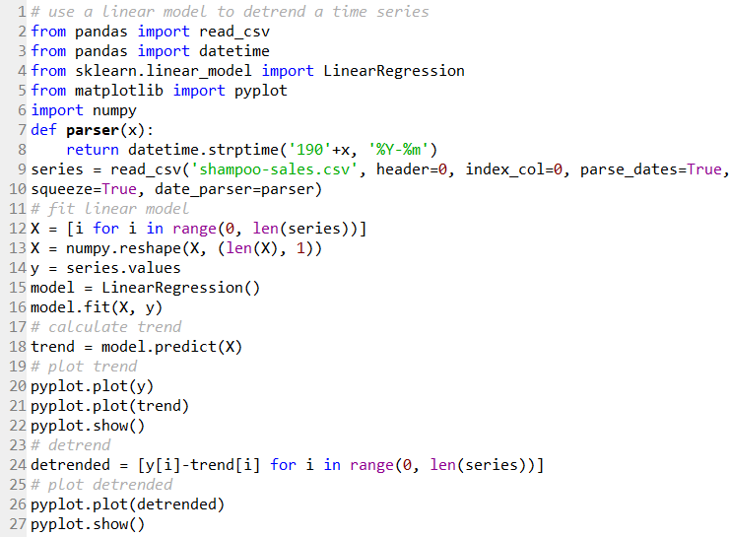
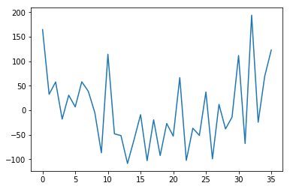
Curve-fitting and subtracting trend
From Brownlee Chapter 13.4:
Linear fit

Slide 6
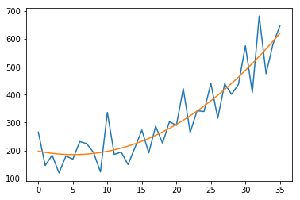
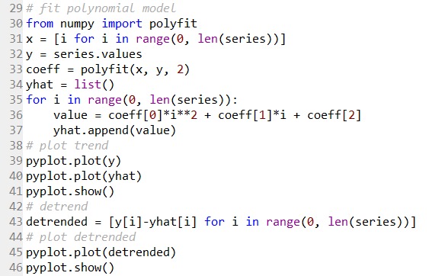
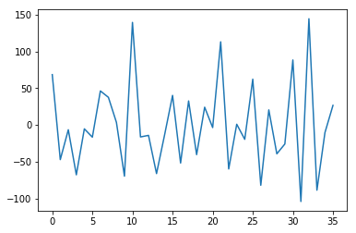
Curve-fitting and subtracting trend
Polynomial fit

Slide 7

Increase order until stationarity is achieved
ADF Statistic: 3.060142
p-value: 1.000000
Critical Values:
1%: -3.724
5%: -2.986
10%: -2.633
ADF Statistic: -1.751410
p-value: 0.404838
Critical Values:
1%: -3.646
5%: -2.954
10%: -2.616
ADF Statistic: -7.135307
p-value: 0.000000
Critical Values:
1%: -3.711
5%: -2.981
10%: -2.630

Slide 8
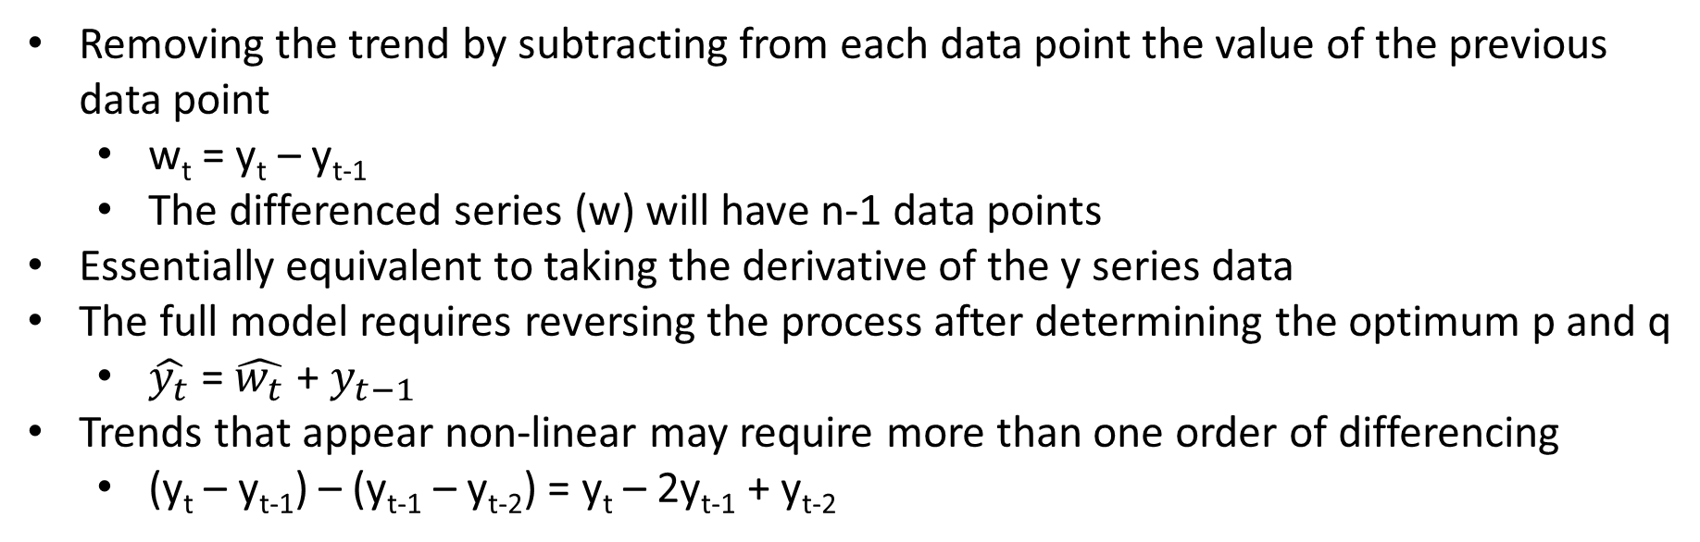
Differencing
Removing the trend by subtracting from each data point the value of the previous data point
w_{t} = y_{t} – y_{t-1}
The differenced series (w) will have n-1 data points
Essentially equivalent to taking the derivative of the y series data
The full model requires reversing the process after determining the optimum p and q
$\hat{y_{t}}$ = $\hat{w_{t}}$ + $y_{t−1}$
Trends that appear non-linear may require more than one order of differencing
(y_{t} – y_{t-1}) – (y_{t-1} – y_{t-2}) = y_{t} – 2y_{t-1} + y_{t-2}

Slide 9
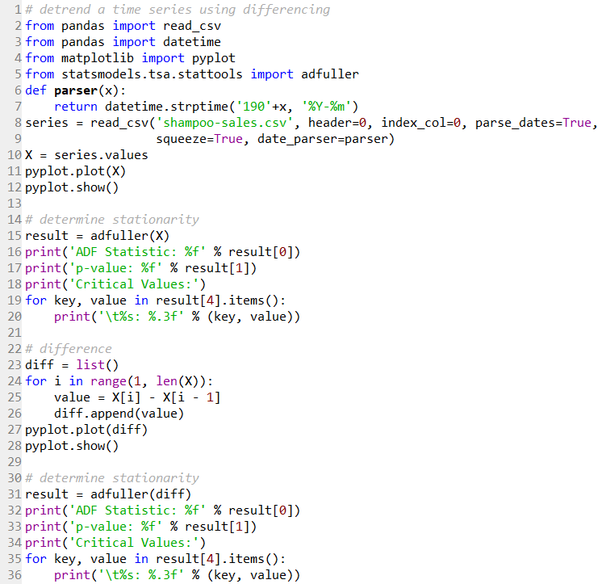
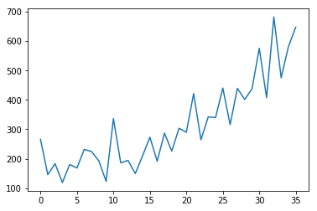
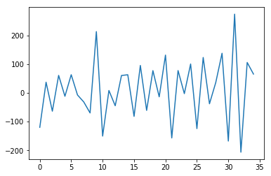
Differencing
From Brownlee Chapter 13.3:
￼
￼
Differencing
ADF Statistic: 3.060142
p-value: 1.000000
Critical Values:
1%: -3.724
5%: -2.986
10%: -2.633
ADF Statistic: -7.249074
p-value: 0.000000
Critical Values:
1%: -3.646
5%: -2.954
10%: -2.616

Slide 10
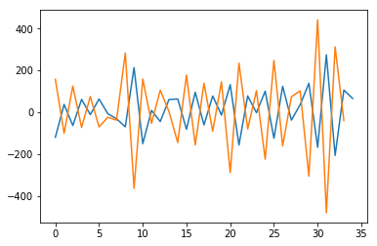
Beware of overdifferencing!
1st difference
2nd difference
ADF Statistic: -7.249074
p-value: 0.000000
Critical Values:
1%: -3.646
5%: -2.954
10%: -2.616
ADF Statistic: -3.715053
p-value: 0.003906
Critical Values:
1%: -3.753
5%: -2.998
10%: -2.639
Looking at the raw data (which has a quadratic shape), one might think that it would require 2 orders of differencing to make stationary.
But in this case, not only is stationarity gained with 1 order of differencing, the ADF statistic actually increases after 2 orders of differencing.
Differencing beyond what is necessary for stationarity can add artifacts to the data which can alter subsequent modeling results.

Slide 11
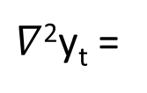
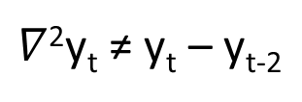
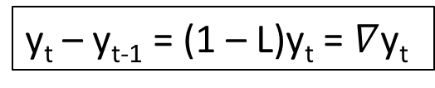
The difference operator
y_{t} – y_{t-1} = (1 – L)y_{t} = $∇$y_{t}
$∇$²y_{t} ≠ y_{t} – y_{t-2}
$∇$²y_{t} =
∇∇y_{t}
∇(y_{t} – y_{t-1})
(y_{t} – y_{t-1}) – (y_{t-1} – y_{t-2})
y_{t} – 2y_{t-1} + y_{t-2}

Slide 12
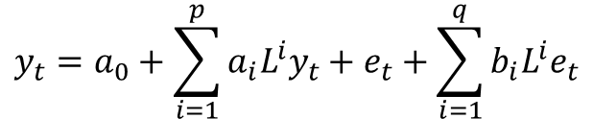
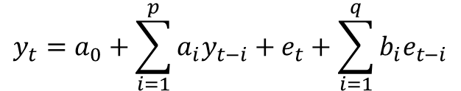
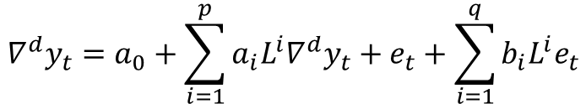
Full ARIMA model expression
ARIMA
Auto-Regressive
Integrated
Moving Average
$$y_{t}=a_{0}+\sum_{i=1}^{p}{a_{i}y_{t−i}}+e_{t}+\sum_{i=1}^{q}{b_{i}e_{t−i}}$$
ARMA(p,q) model:
$$y_{t}=a_{0}+\sum_{i=1}^{p}{a_{i}{L^{i}y}_{t}}+e_{t}+\sum_{i=1}^{q}{b_{i}{L^{i}e}_{t}}$$
$${∇^{d}y}_{t}=a_{0}+\sum_{i=1}^{p}{a_{i}{L^{i}∇^{d}y}_{t}}+e_{t}+\sum_{i=1}^{q}{b_{i}{L^{i}e}_{t}}$$
ARIMA(p,d,q) model:

Slide 13
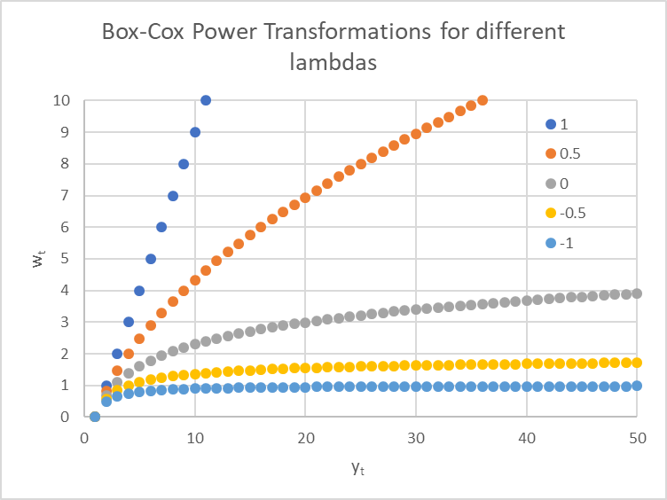




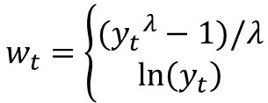

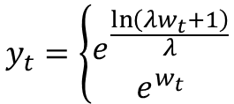
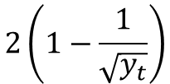



Box-Cox Power Transforms
$$λ$$
$$w_{t}$$
$$w_{t}=\left\{\begin{matrix}({y_{t}}^{λ}−1)/λ \\ \ln\left(y_{t}\right)\end{matrix}\right.$$
$$\begin{matrix}λ≠0 \\ λ=0\end{matrix}$$
1
$$y_{t}−1$$
0.5
$$2(\sqrt{y_{t}}−1)$$
0
$$\ln\left(y_{t}\right)$$
-0.5
$$2\left(1−\frac{1}{\sqrt{y_{t}}}\right)$$
-1
$$1−\frac{1}{y_{t}}$$
$$y_{t}=\left\{\begin{matrix}e^{\frac{\ln\left(λw_{t}+1\right)}{λ}} \\ e^{w_{t}}\end{matrix}\right.$$
Transforming back:
$$\begin{matrix}λ≠0 \\ λ=0\end{matrix}$$

Slide 14
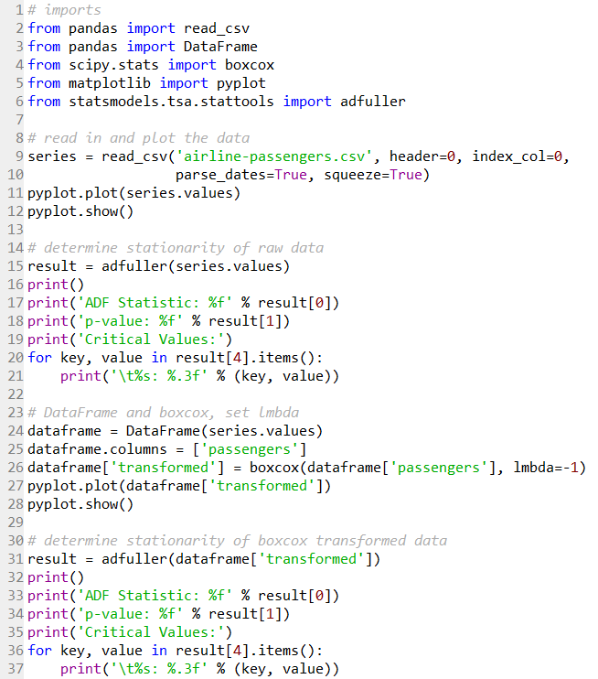
Box-Cox example
Brownlee Chapter 8.4

Slide 15
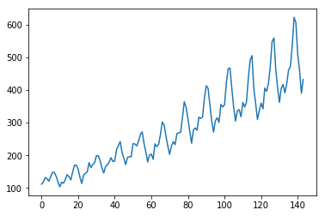
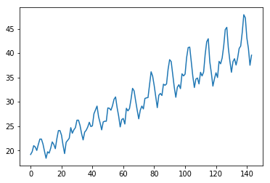
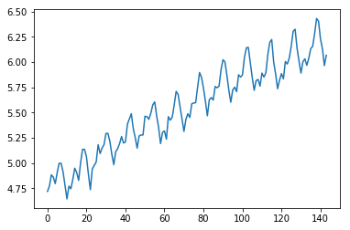
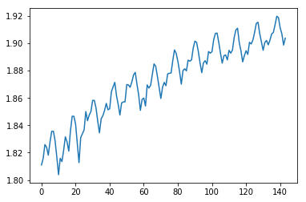
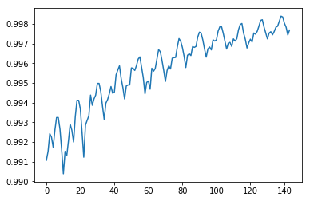
Box-Cox example
λ = 1
(same as raw data)
λ = 0.5
λ = 0
λ = -0.5
λ = -1
ADF Statistic: 0.815369
p-value: 0.991880
Critical Values:
1%: -3.482
5%: -2.884
10%: -2.579
ADF Statistic: -0.345854
p-value: 0.918754
Critical Values:
1%: -3.482
5%: -2.884
10%: -2.579
ADF Statistic: -1.717017
p-value: 0.422367
Critical Values:
1%: -3.482
5%: -2.884
10%: -2.579
ADF Statistic: -2.800729
p-value: 0.058170
Critical Values:
1%: -3.482
5%: -2.884
10%: -2.579
ADF Statistic: -3.584421
p-value: 0.006066
Critical Values:
1%: -3.482
5%: -2.884
10%: -2.579

Slide 16
Deseasonalizing

Slide 17
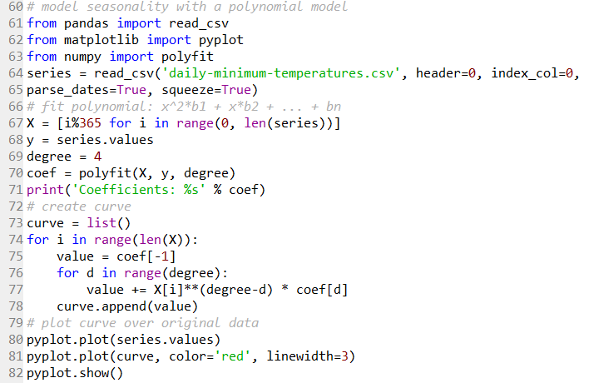
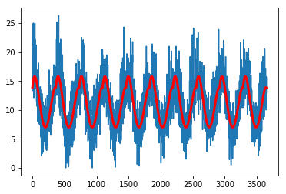
A slick way of characterizing seasonality
365 x 10 = 3650 data points
Brownlee Chapter 14.4
 | Coef |  | Value
a₄ | 0 | -5 | -1.17308000E-08
a₃ | 1 | -4 | 9.30253946E-06
a₂ | 2 | -3 | -2.15977594E-03
a₁ | 3 | -2 | 1.19147966E-01
a₀ | 4 | -1 | 1.38980178E+01
Creates a repeating series 0-364 to index with each y data point
value = coef[-1] +
coef[0]X_{i}⁴ +
coef[1]X_{i}³ +
coef[2]X_{i}² +
coef[3]X_{i}¹

Slide 18
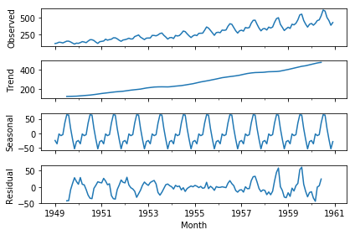
Seasonal Decomposition
statsmodels.tsa.seasonal.seasonal_decompose(x, model='additive', filt=None, freq=None,
two_sided=True, extrapolate_trend=0)
‘airline-passengers’ example:
Uses a convolution filter to determine the trend
Subtracts the trend from the original data set
Determines the seasonal component from the detrended data
Must specify the period (freq)
The data in each period is identical (handy!)
Subtracts the seasonal component from the detrended data to yield the residuals
Plots the original data set, trend, seasonal, and residual components separately

Slide 19
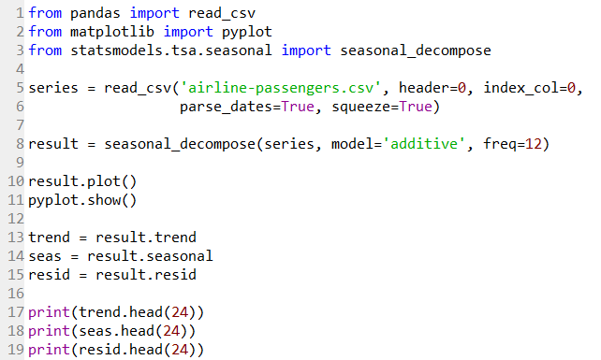
Seasonal Decomposition
trend
seas
resid
Brownlee Chapter 12.4:
Month
1949-01-01 NaN
1949-02-01 NaN
1949-03-01 NaN
1949-04-01 NaN
1949-05-01 NaN
1949-06-01 NaN
1949-07-01 126.791667
1949-08-01 127.250000
1949-09-01 127.958333
1949-10-01 128.583333
1949-11-01 129.000000
1949-12-01 129.750000
1950-01-01 131.250000
1950-02-01 133.083333
1950-03-01 134.916667
1950-04-01 136.416667
1950-05-01 137.416667
1950-06-01 138.750000
1950-07-01 140.916667
1950-08-01 143.166667
1950-09-01 145.708333
1950-10-01 148.416667
1950-11-01 151.541667
1950-12-01 154.708333
Month
1949-01-01 -24.748737
1949-02-01 -36.188131
1949-03-01 -2.241162
1949-04-01 -8.036616
1949-05-01 -4.506313
1949-06-01 35.402778
1949-07-01 63.830808
1949-08-01 62.823232
1949-09-01 16.520202
1949-10-01 -20.642677
1949-11-01 -53.593434
1949-12-01 -28.619949
1950-01-01 -24.748737
1950-02-01 -36.188131
1950-03-01 -2.241162
1950-04-01 -8.036616
1950-05-01 -4.506313
1950-06-01 35.402778
1950-07-01 63.830808
1950-08-01 62.823232
1950-09-01 16.520202
1950-10-01 -20.642677
1950-11-01 -53.593434
1950-12-01 -28.619949
Month
1949-01-01 NaN
1949-02-01 NaN
1949-03-01 NaN
1949-04-01 NaN
1949-05-01 NaN
1949-06-01 NaN
1949-07-01 -42.622475
1949-08-01 -42.073232
1949-09-01 -8.478535
1949-10-01 11.059343
1949-11-01 28.593434
1949-12-01 16.869949
1950-01-01 8.498737
1950-02-01 29.104798
1950-03-01 8.324495
1950-04-01 6.619949
1950-05-01 -7.910354
1950-06-01 -25.152778
1950-07-01 -34.747475
1950-08-01 -35.989899
1950-09-01 -4.228535
1950-10-01 5.226010
1950-11-01 16.051768
1950-12-01 13.911616
Each series can be accessed separately. Particularly useful towards reapplying the seasonal component after modeling the deseasonalized data.

Slide 20
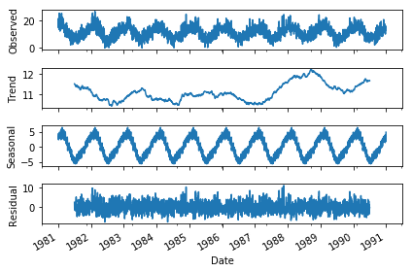
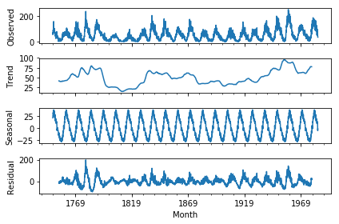
Seasonal Decomposition
 | Shampoo Sales | Minimum Daily Temperatures | Monthly Sunspots | Daily Female Births | Airline Passengers
Observations | 36 | 3650 | 2820 | 365 | 144
Trend | X |  |  |  | X
Seasonality |  | X | X |  | X
Observed
Trend
Seasonal
Residual
freq = 365
freq = 132
(11 years x 12 months)
freq = 12

Slide 21
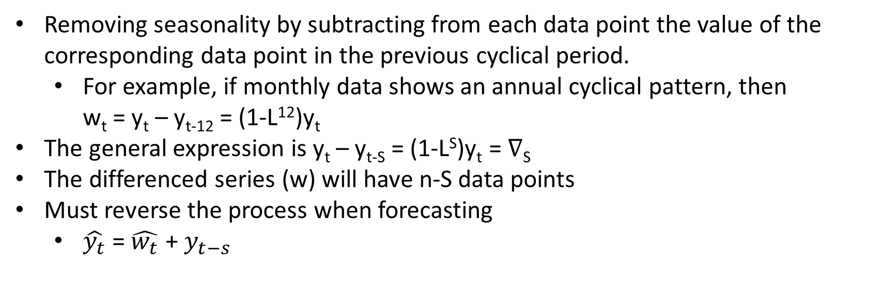
Seasonal Differencing
Removing seasonality by subtracting from each data point the value of the corresponding data point in the previous cyclical period.
For example, if monthly data shows an annual cyclical pattern, then w_{t} = y_{t} – y_{t-12} = (1-L¹²)y_{t}
The general expression is y_{t} – y_{t-S} = (1-L^{S})y_{t} = $∇$_{S}
The differenced series (w) will have n-S data points
Must reverse the process when forecasting
$\hat{y_{t}}$ = $\hat{w_{t}}$ + $y_{t−s}$

Slide 22
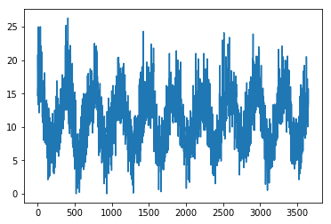
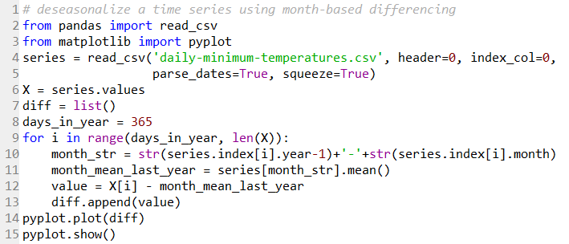
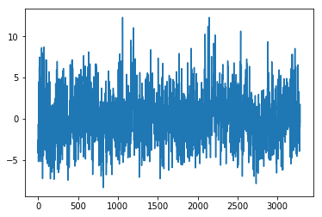
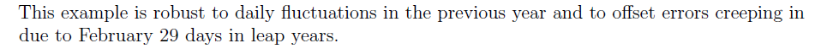
Seasonal Differencing
Brownlee Chapter 14.3:

Slide 23
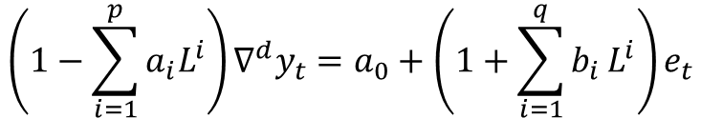
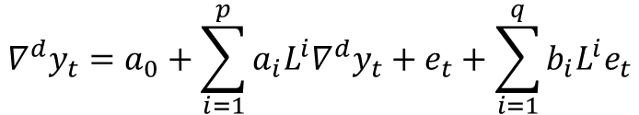

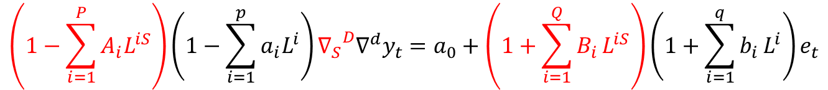
SARIMA model expression
$${∇^{d}y}_{t}=a_{0}+\sum_{i=1}^{p}{a_{i}{L^{i}∇^{d}y}_{t}}+e_{t}+\sum_{i=1}^{q}{b_{i}{L^{i}e}_{t}}$$
ARIMA(p,d,q) model:
$$\left(1−\sum_{i=1}^{p}{a_{i}L^{i}}\right)∇^{d}y_{t}=a_{0}+\left(1+\sum_{i=1}^{q}{b_{i}}L^{i}\right)e_{t}$$
Which is the same as:
$$\left(1−\sum_{i=1}^{P}{A_{i}L^{iS}}\right)\left(1−\sum_{i=1}^{p}{a_{i}L^{i}}\right){{∇_{S}}^{D}∇}^{d}y_{t}=a_{0}+\left(1+\sum_{i=1}^{Q}{B_{i}}L^{iS}\right)\left(1+\sum_{i=1}^{q}{b_{i}}L^{i}\right)e_{t}$$
SARIMA (p,d,q) x (P,D,Q)_{S} model:
Where:
$${∇_{S}}^{D}={\left(1−L^{S}\right)}^{D}$$

Slide 24
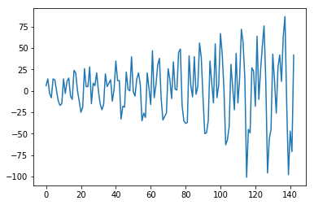
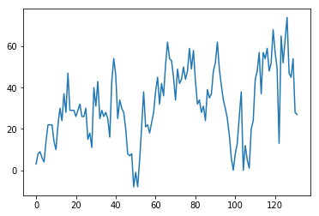
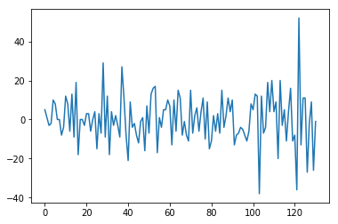
Seasonal differencing example
Raw data
d = 1
D = 1
(S = 12)
d = 1
D = 1
International airline passengers
(monthly totals in thousands)
Single differencing doesn’t address seasonality and (in this case) doesn’t ensure stationarity
Seasonal differencing removes seasonality and (in this case) does a better job of improving stationarity
Applying both regular and seasonal differencing addresses both issues
ADF Statistic: 0.815369
p-value: 0.991880
Critical Values:
1%: -3.482
5%: -2.884
10%: -2.579
ADF Statistic: -2.829267
p-value: 0.054213
Critical Values:
1%: -3.482
5%: -2.884
10%: -2.579
ADF Statistic: -3.383021
p-value: 0.011551
Critical Values:
1%: -3.482
5%: -2.884
10%: -2.579
ADF Statistic: -15.595618
p-value: 0.000000
Critical Values:
1%: -3.482
5%: -2.884
10%: -2.579

Slide 25
Smoothing/Filtering

Slide 26
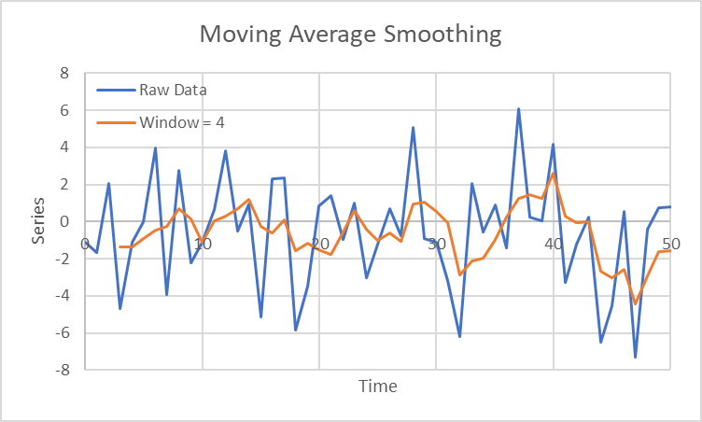


Simple Moving Average
Moving window
$$S_{t}= \frac{1}{n}\sum_{i=0}^{n−1}{y_{t−i}}$$
For example:
$$S_{t}=\frac{y_{t}+y_{t−1}+y_{t−2}+y_{t−3}}{4}$$

Slide 27
Exponential Moving Average
S_{t} = α[Y_{t-1} + (1 – α)Y_{t-2} + (1 – α)²Y_{t-3} + (1 – α)³Y_{t-4} + … ]
Where: Y is the original data series
S is the smoothed data series
α is the smoothing factor, a value between 0 and 1
Exponential smoothing assigns exponentially decreasing weighting to Y values with larger lags.
The above equation simplifies to:
S_{t} = αY_{t-1} + (1 – α)S_{t-1}
An alternate approach uses Y_{t} instead of Y_{t-1}:
S_{t} = αY_{t} + (1 – α)S_{t-1}
Average of first few Y series values
S_{t} = αY_{t-1} + (1 – α)S_{t-1}
t

Slide 28

Exponential Moving Average
S_{t} = αY_{t-1} + (1 – α)S_{t-1}
The initial S_{t-1} value is typically chosen as an average of the first few Y observations
α = 1:
S_{t} = Y_{t-1}
(no smoothing)
α = 0:
S_{t} = initial value of S_{t-1}
(flat line, independent of Y)

Slide 29


Hodrick-Prescott Filtering
Natural log of the time series variable
Trend component
Cyclical component
Error component
$$y_{t}=τ_{t}+c_{t}+e_{t}$$
Find the trend component that solves:
$$\min_{τ}\left(\sum_{t=1}^{T}{{\left(y_{t}−τ_{t}\right)}^{2}}+λ\sum_{t=2}^{T−1}{{\left[\left(τ_{t+1}−τ_{t}\right)−\left(τ_{t}−τ_{t−1}\right)\right]}^{2}}\right)$$
Suggested values for λ:
Monthly: 1600 x 3⁴ = 129,600
Quarterly: 1600
Annually: 1600 x (1/4)⁴ = 6.25
This term penalizes the cyclical component
This term penalizes variations in the growth rate of the trend component

Slide 30

HP Filtering in Python

Slide 31


HP Filtering in Python

Slide 32


Affect of λ on filtering
Ignoring the fact that the data is quarterly data, and assuming that it is as noted below
42 years
42 months (3.5 years)
= 6.25
(assuming annual data)
= 1600
(quarterly data)
= 129,600
(assuming monthly data)

Slide 33

HP filtering is controversial
See “Drawbacks to the Hodrick-Prescott filter” in: https://en.wikipedia.org/wiki/Hodrick%E2%80%93Prescott_filter
http://econweb.ucsd.edu/~jhamilto/hp.pdf

